Slide 1
ESTATE PLANNING 101
Presenter: Ranvir Sandhu

Slide 2
Ranvir S. Sandhu, J.D.
Practice Areas
Estate Planning
Corporate Law
Notes:
Describe a little bit about yourself.

Slide 3
Please Note
This presentation contains general legal information and not specific legal advice.
E S T A T E P L A N N I N G 1 0 1

Slide 4
Make decisions now so that you have a say in how your future plays out.
E S T A T E P L A N N I N G 1 0 1
Notes:
Good news! There are two solutions.

Slide 5
M Y T H :
“I don’t have an estate”.
E S T A T E P L A N N I N G 1 0 1

Slide 6
Estate: Your Net Worth in the
Eyes of the Law
Your Net Worth Includes
Bank accounts
Real Estate (they look at the value, not what you owe on it for Probate fees)
Retirement Accounts
Cash Value of Life Insurance
Automobiles
Any ownership or licenses you have for a trademark
Social media accounts
Any other assets you have to your name
E S T A T E P L A N N I N G 1 0 1
Notes:
What exactly is estate planning? There is a also a federal estate tax for estates that are in excess of 5.4 - cumulative between when you are alive and dead.
Transfer of assets - at death

Slide 7
An estate is more than everything you own, it’s also everything you owe.
E S T A T E P L A N N I N G 1 0 1
Notes:
Debt

Slide 8
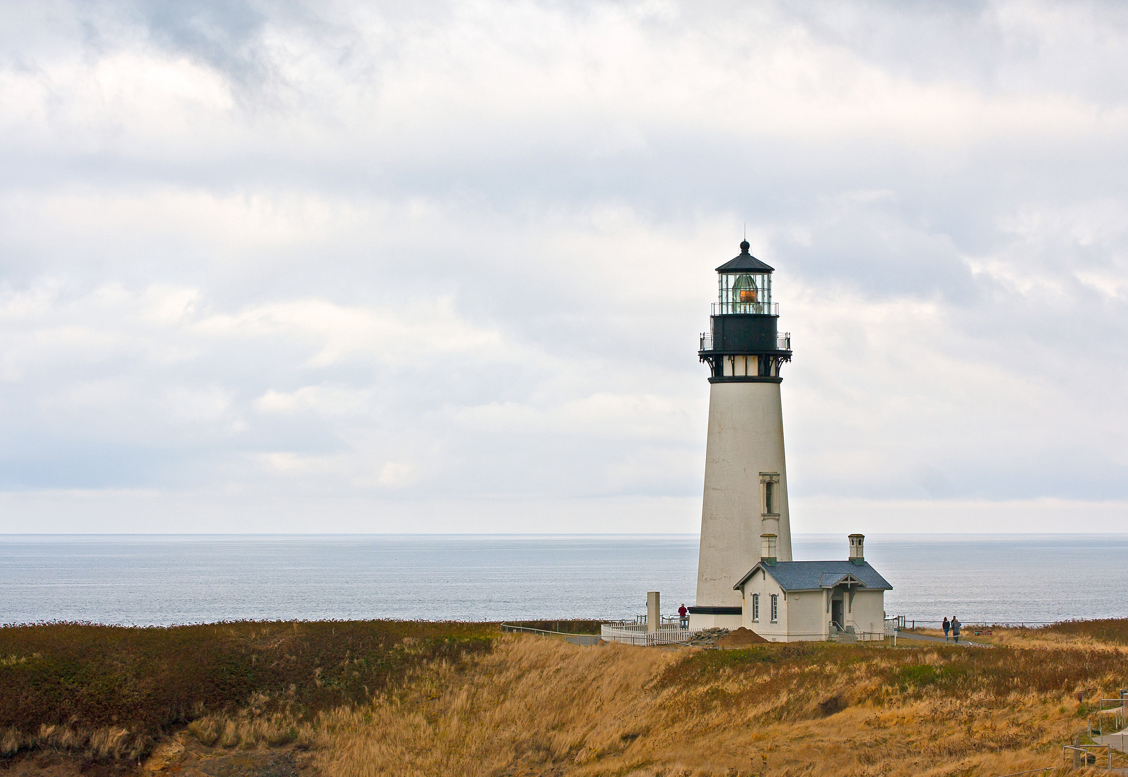
M Y T H :
I’m simple. Just my wife & me. We own one house and it’s going to our kids.
E S T A T E P L A N N I N G 1 0 1

Slide 9
What makes Estate Planning important:
Real Estate: Joint Tenants With Rights of Survivorship, Community Property, Tenants in Common
Minor beneficiaries need guardians and backup guardians assigned in case the state send them to the State’s foster care system
Capacity to make legal and medical decisions
Citizenship of client, spouse, successor trustee
Out of state property in the US (anything outside of the U.S.A (i.e. India or China) is not a part of the estate plan; you need to speak to attorneys over there for that
E S T A T E P L A N N I N G 1 0 1
Notes:
15 minutes.

Slide 10
HYPOTHETICAL #1
E S T A T E P L A N N I N G 1 0 1

Slide 11
HYPOTHETICAL #1: ANSWER
For people with:
NO real estate
Less than $184,500 in Assets
NO kids
NO special needs beneficiaries
Documents Needed:
Will
Advance Health Care Directive / Living Will
Durable Power of Attorney
Check your beneficiary designations
E S T A T E P L A N N I N G 1 0 1
Notes:
Unless you have less than 150,000 you should have a Trust (Small Estates Affidavit Procedure).
Double Check his beneficiary designation

Slide 12
Last Will & Testament
Use if you would like:
Your property distributed according to your wishes
You’d like to list the people or organization that will receive your property
You’d like to name an executor
You’d like to name a guardian for your children so their fate does not potentially go to the State by the foster care system and potentially different homes
E S T A T E P L A N N I N G 1 0 1

Slide 13
Advanced Health Care Directive /
Living Will
Becomes active at your incapacity; when you are aware and sane, it stops working
Appoints a person who’s authorized to make medical decisions on your behalf
Authorizes medical professionals to release confidential medical information to the appointed persons
Also Known As: Living Will — Advanced Healthcare Directive (Cal. Probate Code Sec. 4701)
E S T A T E P L A N N I N G 1 0 1

Slide 14
Durable Power of Attorney
Who will make your financial decisions?
A Durable Power of Attorney is valid before and after you’ve become incapacitated.
With Durable Power of Attorney, someone has the ability to:
Write checks
Sign official documents
Handle other legal matters on your behalf
E S T A T E P L A N N I N G 1 0 1

Slide 15
HYPOTHETICAL #2
E S T A T E P L A N N I N G 1 0 1

Slide 16
HYPOTHETICAL #2: ANSWER
For people with:
Real estate
More than $184,500 in Assets
NO kids
NO special needs beneficiaries
Documents Needed:
Revocable / Living Trust
Will
Advance Health Care Directive / Living Will
Durable Power of Attorney
Check your beneficiary designations on retirement accounts & life insurance
E S T A T E P L A N N I N G 1 0 1
Notes:
Unless you have less than 150,000 you should have a Trust (Small Estates Affidavit Procedure). - EXPLAIN POUR OVER WILL
Double Check his beneficiary designation
The most common estate planning document is a Will. Any property that passes under the terms of a Will is subject to probate administration and the supervision of the probate court, unless (1) the estate is very small, in which case it can sometimes be collected by a declaration without probate administration, or (2) the estate passes entirely to a surviving spouse, no administration is necessary or a shortcut method of confirmation of property passing to the spouse may be elected. An often used alternative is a combination of the pour‑over Will and a funded revocable trust. There are no income tax advantages and no estate tax advantages to a revocable trust that cannot be obtained through a Will. The advantages of a revocable trust are: (1) avoidance of probate administration and a reduction of the costs and administrative burdens thereof; (2) privacy; and (3) avoidance of a conservatorship of the estate if a person becomes unable to manage his or her property. The disadvantages of a revocable trust are (1) additional cost to establish the trust and transfer title of assets to the trustee, (2) lack of prior court supervision of the trustee's actions, and (3) some additional administrative burden in operating the trust.

Slide 17
Probate:
The legal process of distributing assets from an estate after death.
Reasons to Avoid Probate:
Time Intensive
Court must inventory everything and decides who gets what
Expensive Process
Loved ones have to deal with court
Public Affair
E S T A T E P L A N N I N G 1 0 1
Notes:
30 minutes.

Slide 18
Revocable Trust
Also known as a Living Trust.
Skip probate and control your assets after your death.
If the trustor becomes incapacitated, the trustee or successor trustee can manage the trust property without the necessity of the probate conservatorship procedure and the related court and legal costs.
Upon the trustor’s death the trustee or successor trustee distributes the trust property without the necessity of probate administration and the related court and legal costs.
The filing fees for probate court have been raised to very high levels.
All information regarding the trust is kept confidential and is not part of the public record.
E S T A T E P L A N N I N G 1 0 1
Notes:
30 minutes.

Slide 19
HYPOTHETICAL #3

Slide 20
For people with:
Some real estate
More than $184,500 in Assets
kids
NO special needs beneficiaries
HYPOTHETICAL #3: ANSWER
Documents needed:
Will
Revocable / Living Trust
Guardianship Nomination (can be included in a will)
Durable Power of Attorney
Advance Health Care Directive / Living Will
Trust Transfer Deed
Cost of a mistake:
Children may not be raised by the people you would nominate and could potentially go to foster care
Children’s estate gets frozen in guardianship of estate
E S T A T E P L A N N I N G 1 0 1

Slide 21
Guardianship Nomination
The person/people you choose as your child’s guardian will be legally responsible for physical care, health, education and welfare until the child is 18.
Keep in mind:
A designated Guardian may refuse responsibility. That’s partly why we ask for backups.
Talk to them first before you name them….and please try and make sure they live in the U.S.A., preferably.
E S T A T E P L A N N I N G 1 0 1

Slide 22
Key Takeaways
Figure out what you own and owe.
Double check your beneficiary designations on retirement accounts and life insurance.
Work with Insight Legal, P.C. to get the appropriate documents in place. If your estate consists only of bank accounts, with no minor beneficiaries, it may be ok to use our attorneys to draft your documents.
If your estate contains real estate, and/or you have minor beneficiaries, and/or you are not a US citizen, or if you simply don’t want to deal with it. Schedule a free consultation with one of our estate planning attorneys.
E S T A T E P L A N N I N G 1 0 1
Notes:
Property in California may have, in general, three characters: separate property, community property, and quasi‑community property.

Slide 23
Common Questions
Q: When do I need to edit/update my estate plan? A: After major life events: buying a house, divorce, having a baby, a large inheritance, changing your executor or trustee. Q: If I leave my company (if going through insurance), what happens to my documents? A: We give you the originals. You will always have access to your documents through Insight Legal, P.C.’s Box folder. Q: Can I name my kids as Executor and Trustee? Yes, if you prefer, but they should be over the age of 18. Q: Can my executor, trustee and/or guardian be residing outside of the U.S.A? We strongly recommend not doing this; do not choose a nonresident and a non-US citizen or green card holder. There can be negative tax implications, not to mention potential immigration issues. Q: Can I edit estate planning documents I’ve already created with an attorney? A: Insight Legal, P.C. can make changes to your documents by amending, cancelling or revoking, but you are free to go to another law firm as well.
E S T A T E P L A N N I N G 1 0 1
Notes:
Property in California may have, in general, three characters: separate property, community property, and quasi‑community property.

Slide 24
Questions about Estate Planning?
Ranvir S. Sandhu, Esq.
(510) 516-2889
info@insightlegalpc.com
www.insightlegalpc.com
Notes:
45 minutes.

